Slide 1






code2vec:
Learning Distributed Representations of Code
Uri Alon, Meital Zilberstein, Omer Levy, Eran Yahav
Facebook AI
Research
Technion

Slide 2

Predicting Properties of Programs
Program
Property
Trained Model
P
$$φ$$

Slide 3
A Motivating Example: Semantic Labeling of Code
String[] _______(final String[] array) { final String[] newArray = new String[array.length]; for (int index = 0; index < array.length; index++) { newArray[array.length - index - 1] = array[index]; } return newArray; }
reverseArray
77.34%
reverse
18.18%
subArray
1.45%

Slide 4

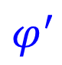
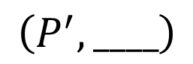
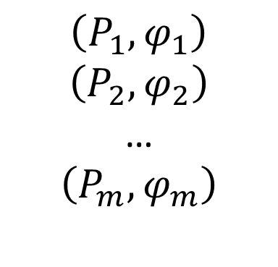
Program
Property
Trained Model
P
$$φ$$
$$\left(P_{1}, φ_{1}\right)$$
$$\left(P_{2}, φ_{2}\right)$$
…
$$\left(P_{m},φ_{m}\right)$$
Training data
(millions of examples):
Test data:
$$φ^{′}$$
$$\left(P^{′}, ____\right)$$

Slide 5
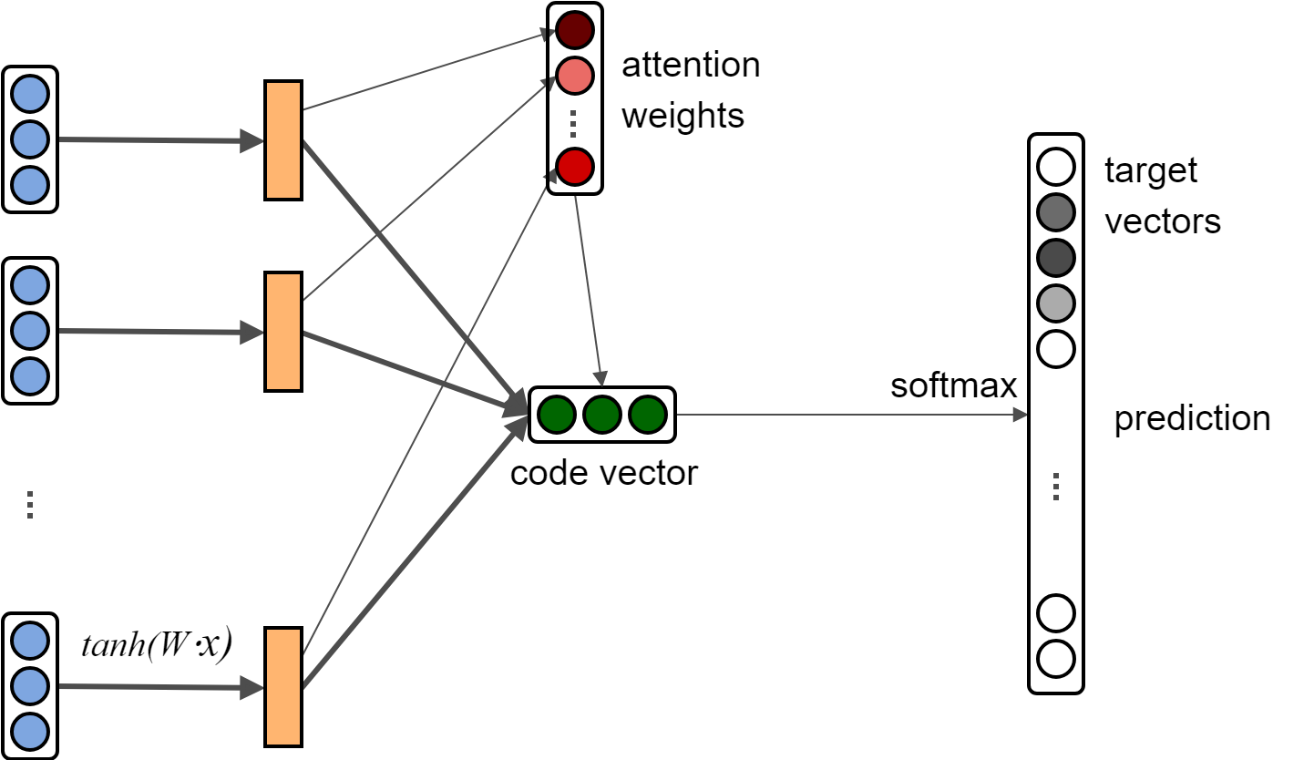
Program
Property
P
$$φ$$
$$\left(P_{1}, φ_{1}\right)$$
$$\left(P_{2}, φ_{2}\right)$$
…
$$\left(P_{m},φ_{m}\right)$$
Training data
(millions of examples):
Test data:
$$φ^{′}$$
$$\left(P^{′}, ____\right)$$

Slide 6
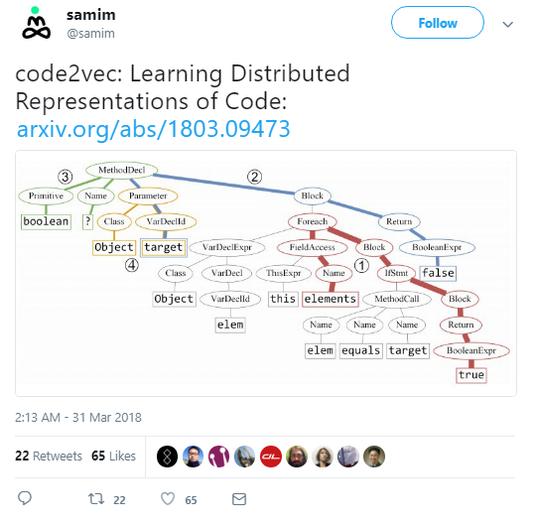
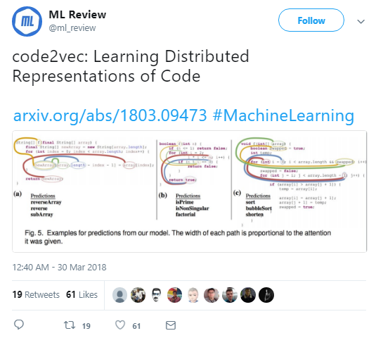
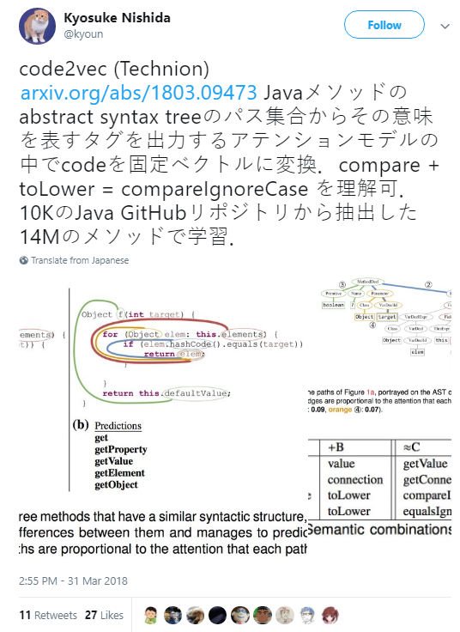
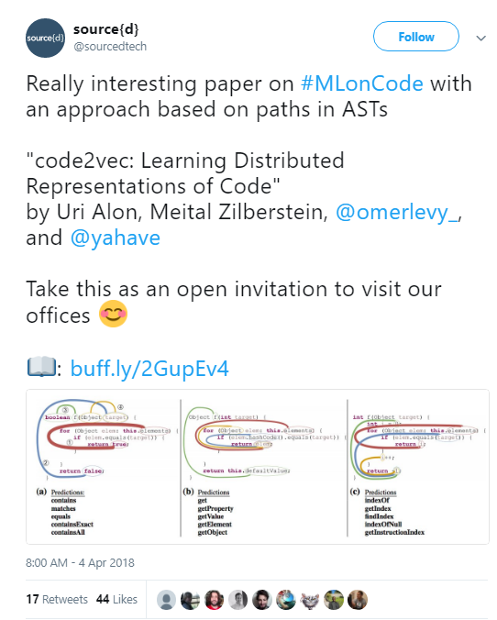
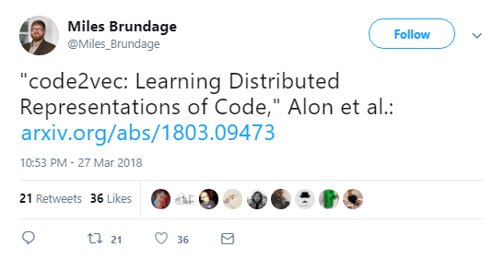
Code2vec: a neural network for predicting properties of code

Slide 7
Code2vec: a neural network for predicting properties of code
Example application: predicting method names
String[] ______(...) { final String[] = ...; ... return newArray; }
reverseArray
A general approach – has many possible applications:
Yes/no malware, required dependencies, keywords / hashtags, clone detection…

Slide 8
How does code2vec work?

Slide 9


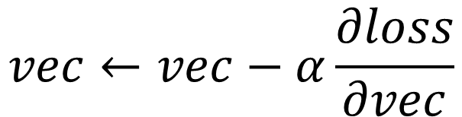
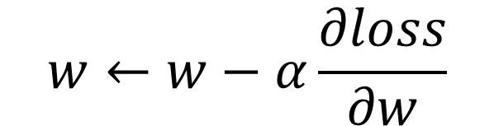


Neural Networks
Sequences of simple algebraic functions over vectors and matrices
A simple example: Predict how positive is a given sentence (regression)
a
avg.
$$\left[w\right]$$
$$⋅$$
sum( )
Score=
7.6
Truth=
9.4
good
talk
Loss(pred, truth)
$$vec←vec−α\frac{∂loss}{∂vec}$$
$$w←w−α\frac{∂loss}{∂w}$$

Slide 10
Distributed Representations (“embeddings”)
a
good
talk
great
good
sim(good, great) > sim(a, bad)

Slide 11
Back to our problem
Two main challenges in encoding programs:
How to decompose programs to smaller building blocks?
Small enough to repeat across programs
Large enough to be meaningful
How do we aggregate a set of these building blocks?
the “bias-variance tradeoff”

Slide 12

Code2vec: High-level Overview
String[] _____(...) { final String[] = ...; ... return newArray; }
$$φ$$
Decompose
Aggregate
Predict

Slide 13
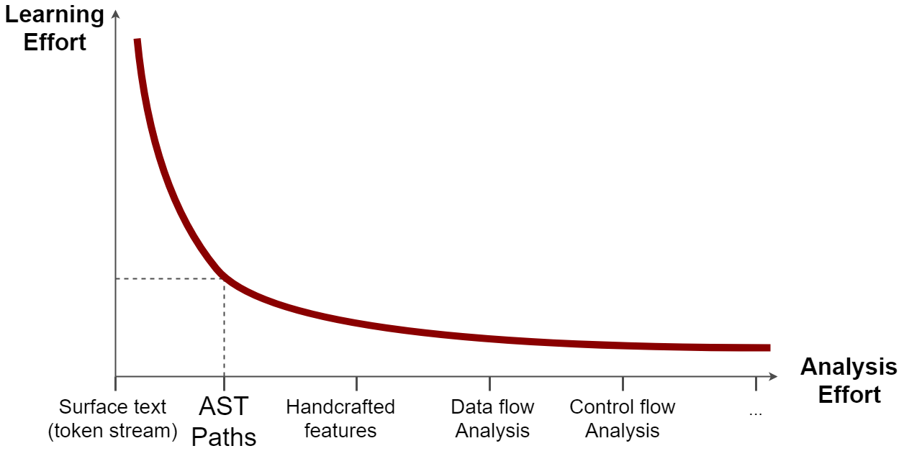
Implicitly re-learn syntactic & semantic regularities
Training
data, time…
Challenge #1: Decomposing Programs
Sweet-spot
Requires expertise, language-specific, task-specific model
[“A General Path-based Representation for Predicting Program Properties”, PLDI’2018]

Slide 14
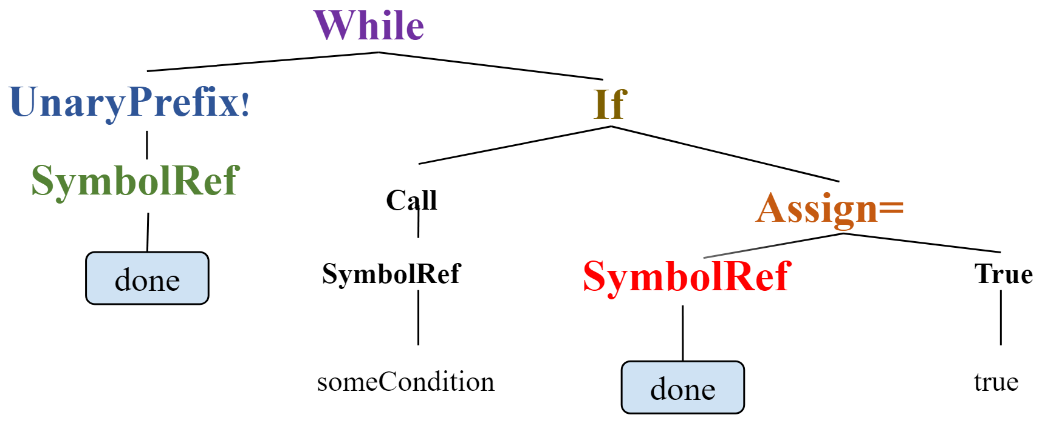
AST-paths
A Program as a Set of AST Paths
while (!done) {
if (someCondition()) {
done = true;
}
}
while (!done) {
if (someCondition()) {
done = true;
}
}
(done, SymbolRef ↑ UnaryPrefix! ↑ While ↓ If ↓ Assign= ↓ SymbolRef , done)
AST paths capture some of the semantics, by using only the syntax.
We represent a program as the set of all its paths.
[“A General Path-based Representation for Predicting Program Properties”, PLDI’2018]

Slide 15


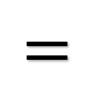
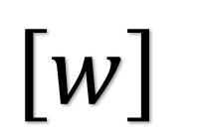
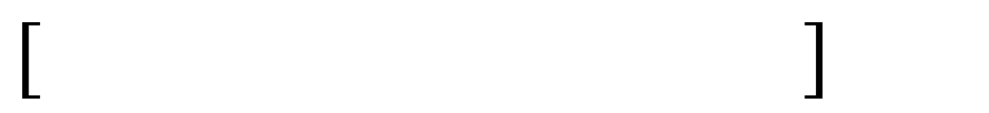
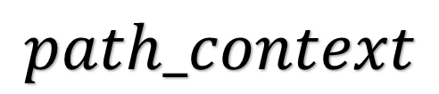
Representing AST-Paths as Vectors
Two sets of learned vectors:
Token vectors
Path vectors
(done, SymbolRef↑UnaryPrefix!↑While↓If↓Assign=↓SymbolRef , done)
lookup
(token vectors)
lookup
(path vectors)
lookup
(token vectors)
$$⋅$$
$$tanh\left( \right)$$
$$\underset{fully−connected layer}{\underbrace{ }}$$
$$\left[w\right]$$
$$=$$
$$path_context$$

Slide 16
Input: an arbitrary-sized set of vectors representing AST paths
Select the “most important vector”
Use all vectors, e.g., by averaging them
Attention – a learned weighted average
Challenge #2: Aggregating a Set of Path-Contexts

Slide 17
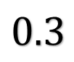

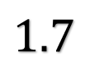
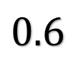

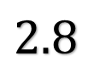
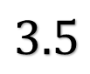
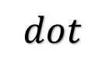

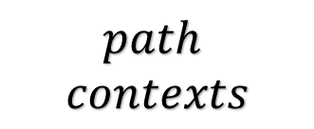

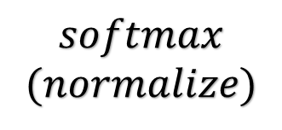
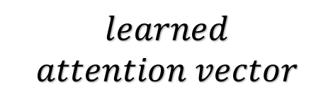
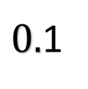

Attention
Core idea - the values of the vectors learn two distinct goals:
The semantic meaning of the path-context
The amount of attention this path-context should get
$$learned$$
$$attention vector$$
$$softmax$$
$$(normalize)$$
$$dot$$
$$⋅$$
$$3.5$$
$$0.6$$
$$code vector$$
$$path$$
$$contexts$$
$$⋅$$
$$sum$$
$$0.3$$
$$2.8$$
$$⋅$$
A learned weighted average!
$$1.7$$
$0.$1

Slide 18
Code2vec Architecture
Bag of contexts
Program
(token1, path, token2)
Decompose
Aggregate
Predict
Predicting method names:
Training set: ~14M examples
Training time: <1 day (very fast) thanks to its simplicity
End-to-end: the entire network is trained simultaneously

Slide 19
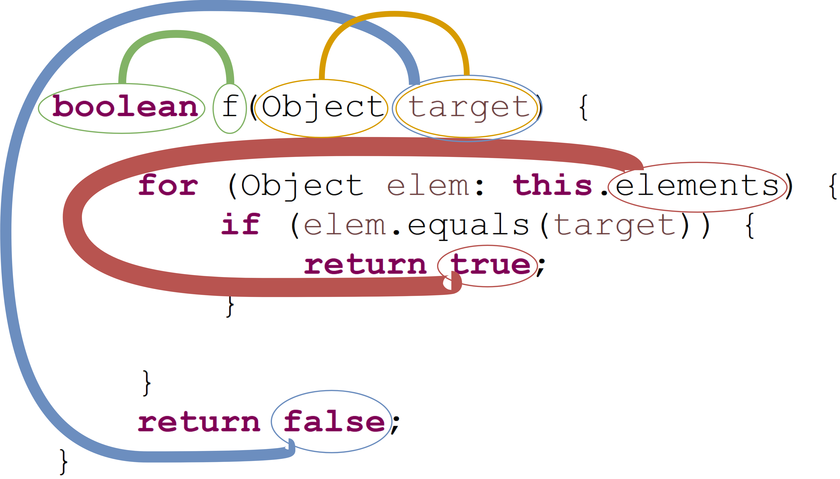
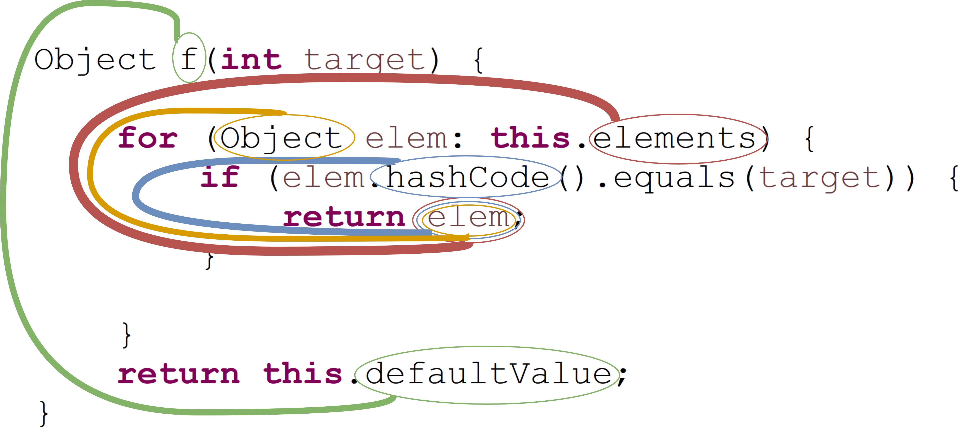
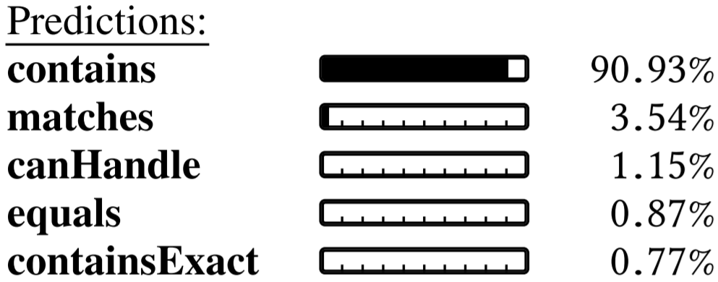
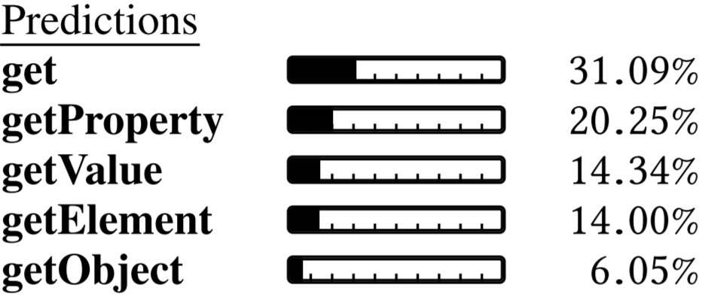

Slide 20
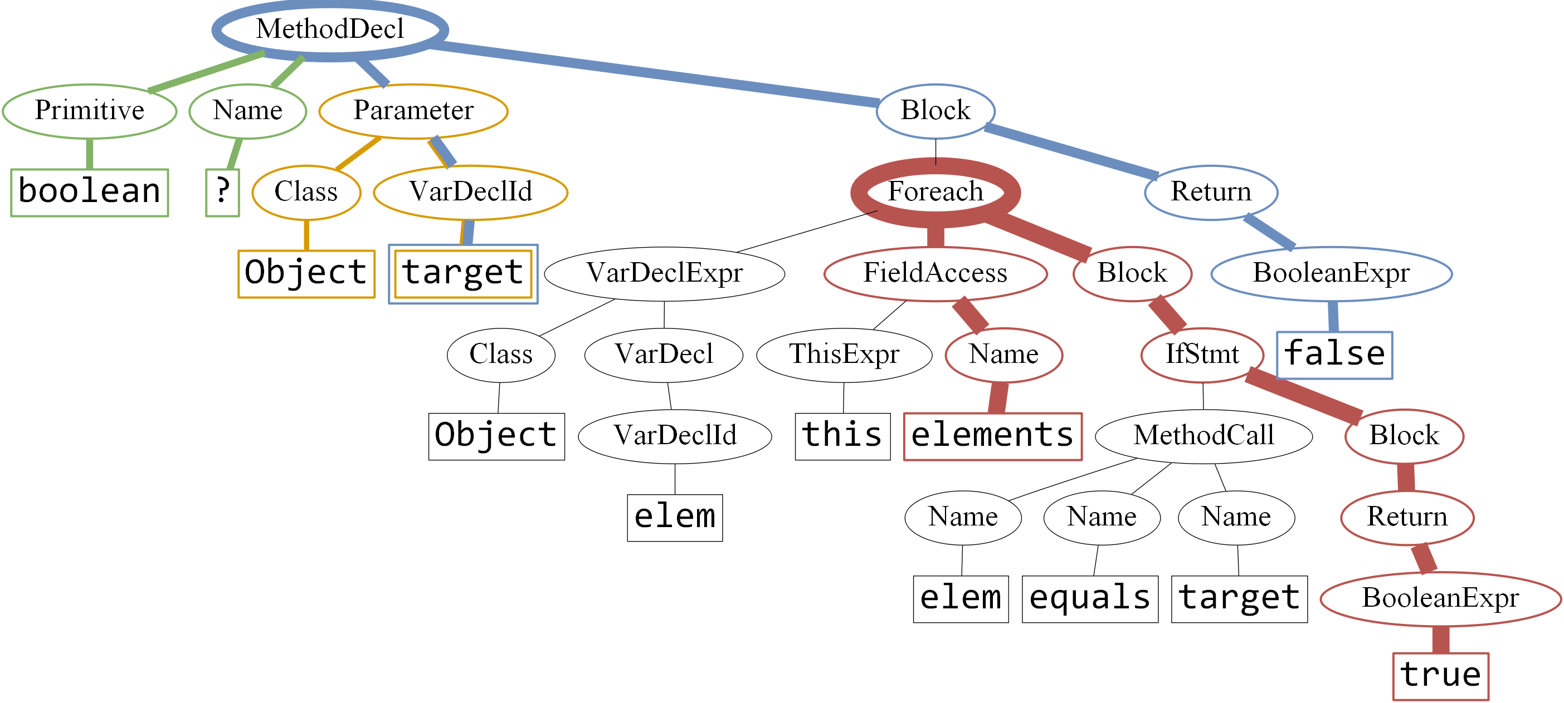
⇒ Attention provides interpretability!

Slide 21
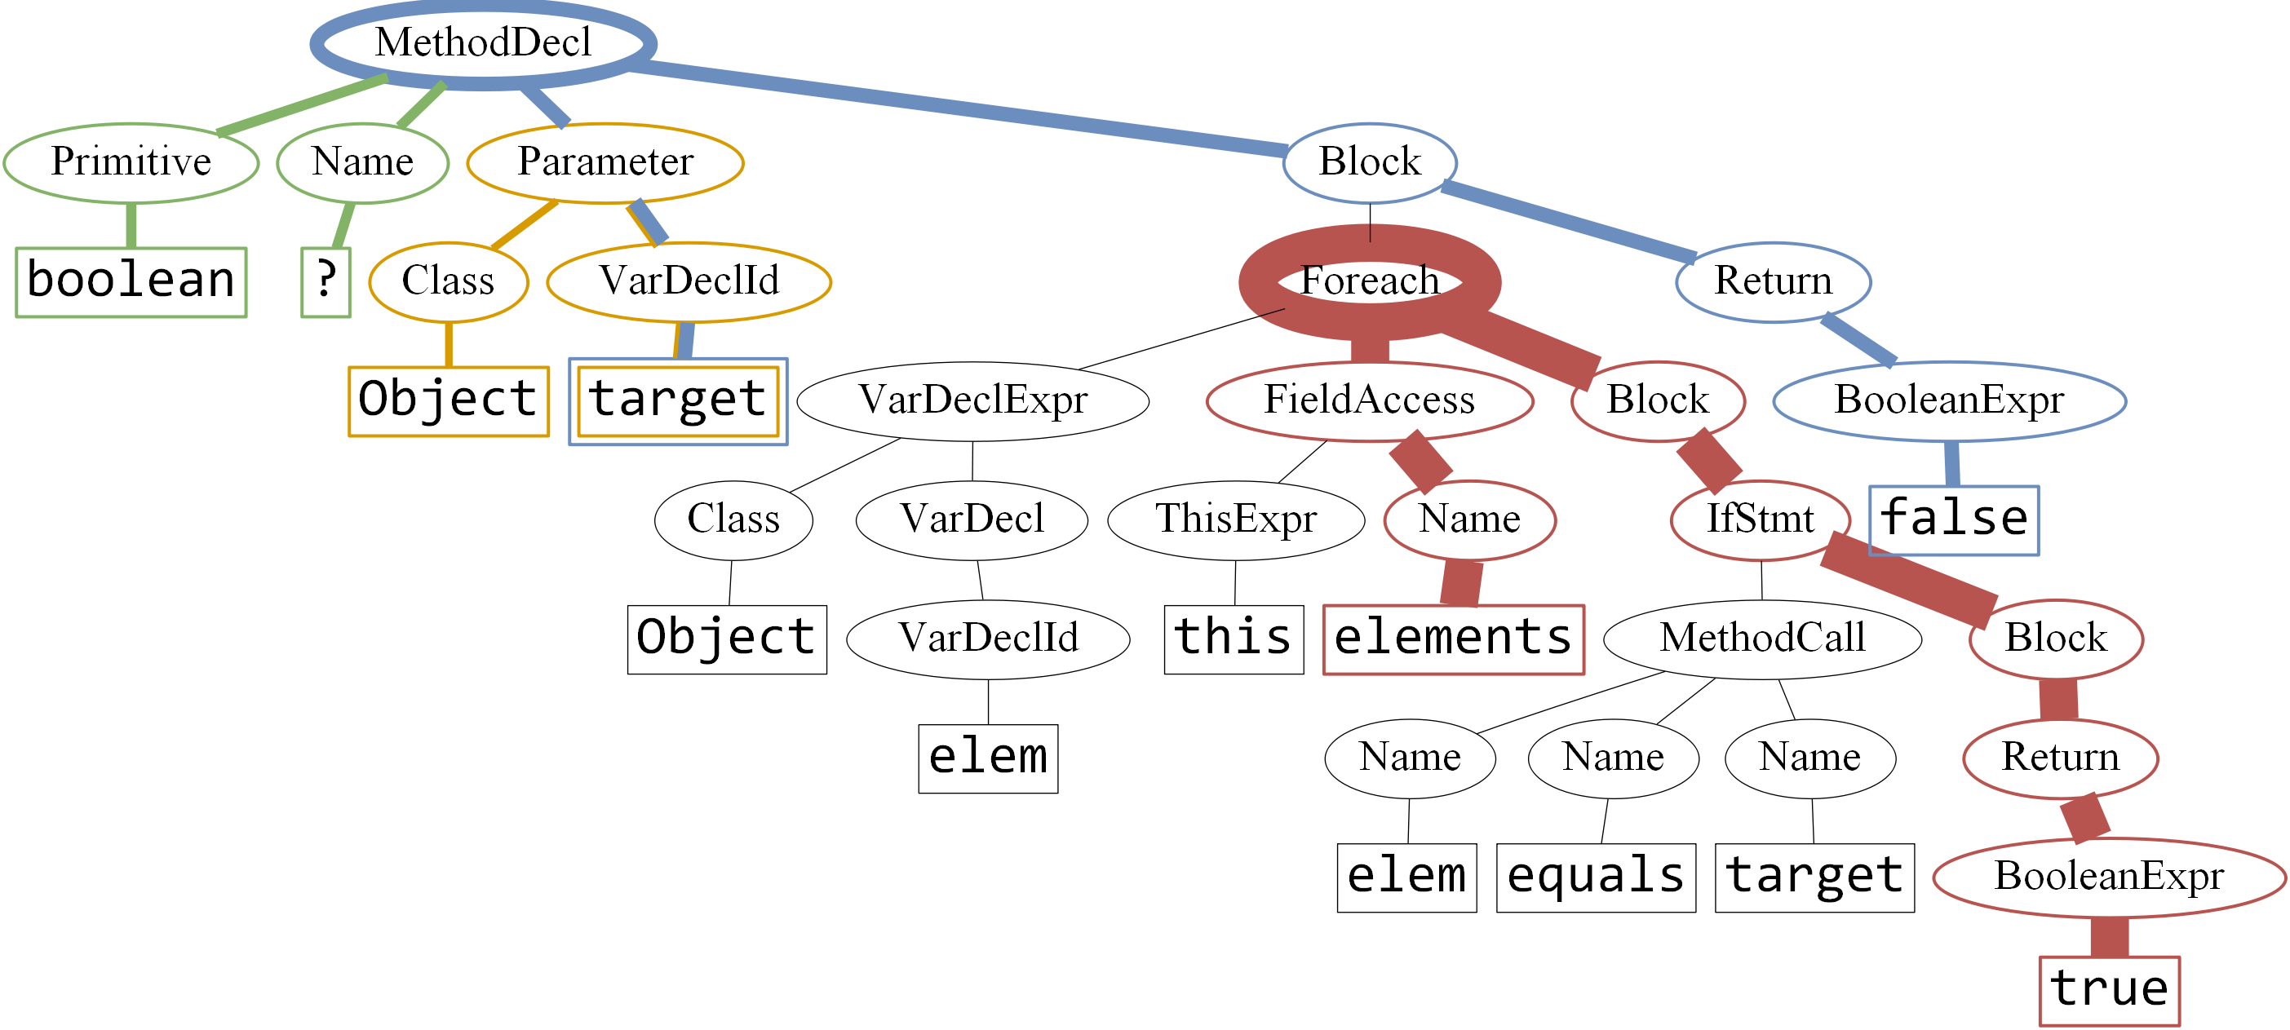
⇒ Attention provides interpretability!

Slide 22
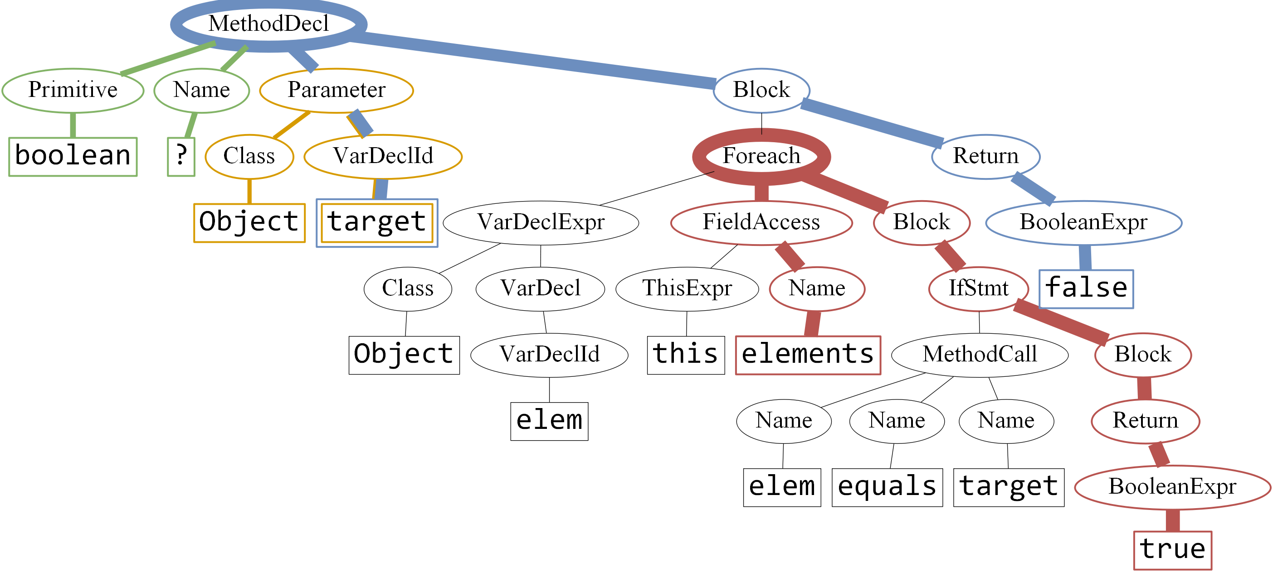
⇒ Attention provides interpretability!

Slide 23
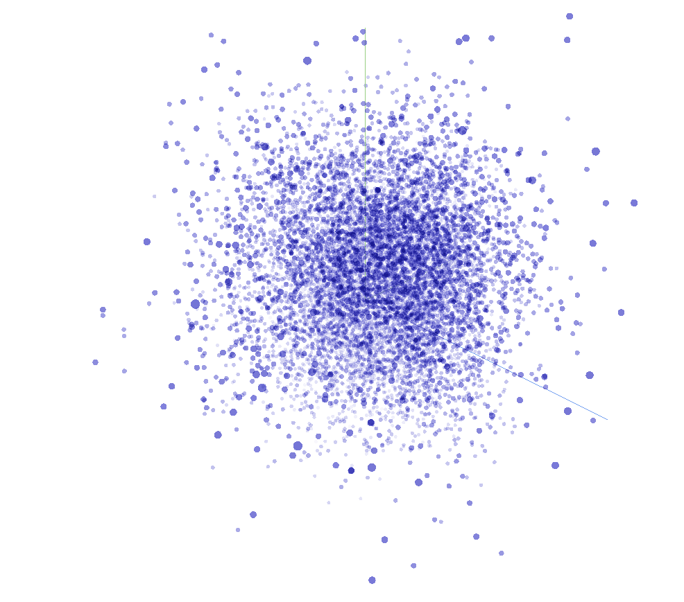
The Vector Space of Target Labels
Cosine-similar vectors are learned for semantically similar labels.

Slide 24
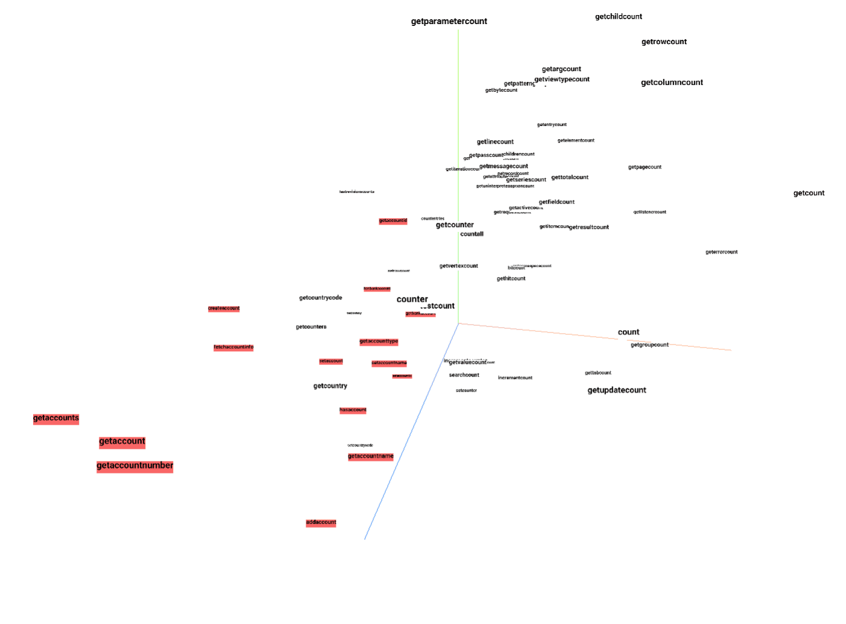
The Vector Space of Target Labels
Cosine-similar vectors are learned for semantically similar labels.

Slide 25
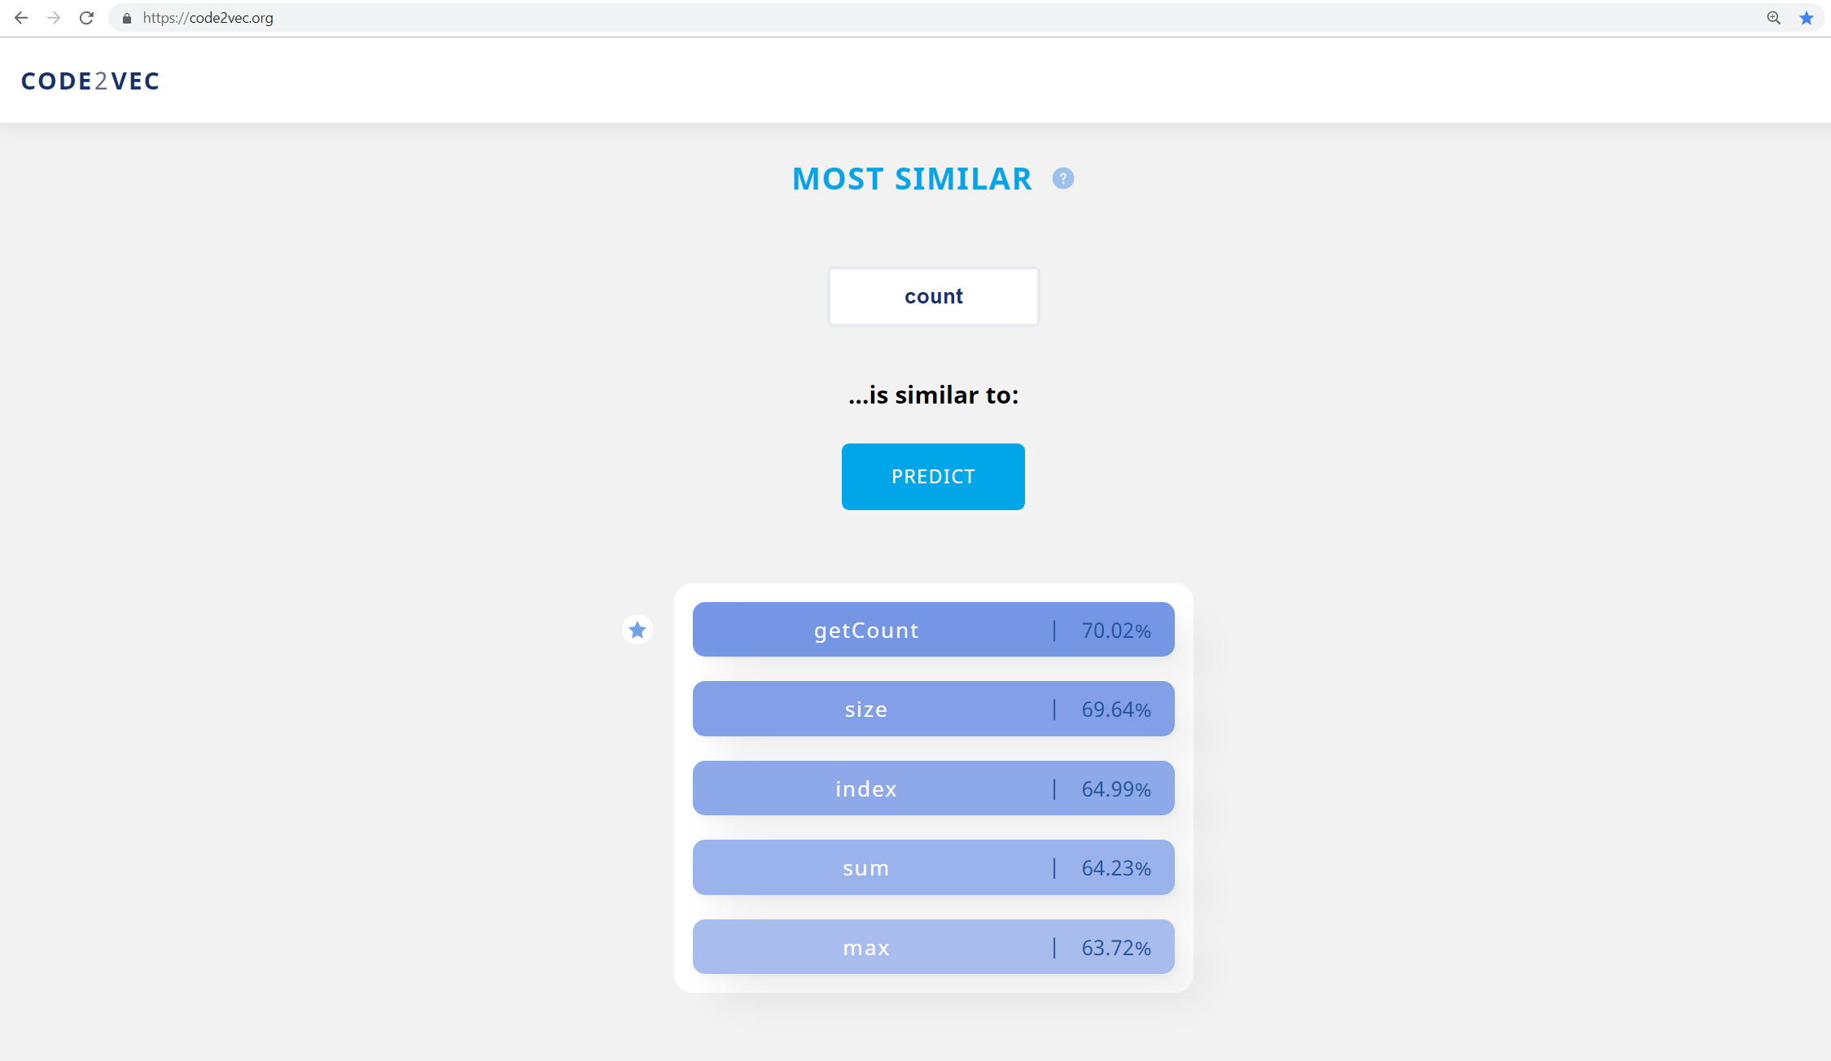

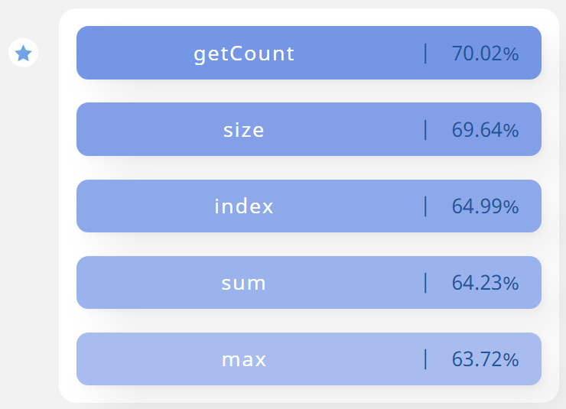

http://code2vec.org

Slide 26
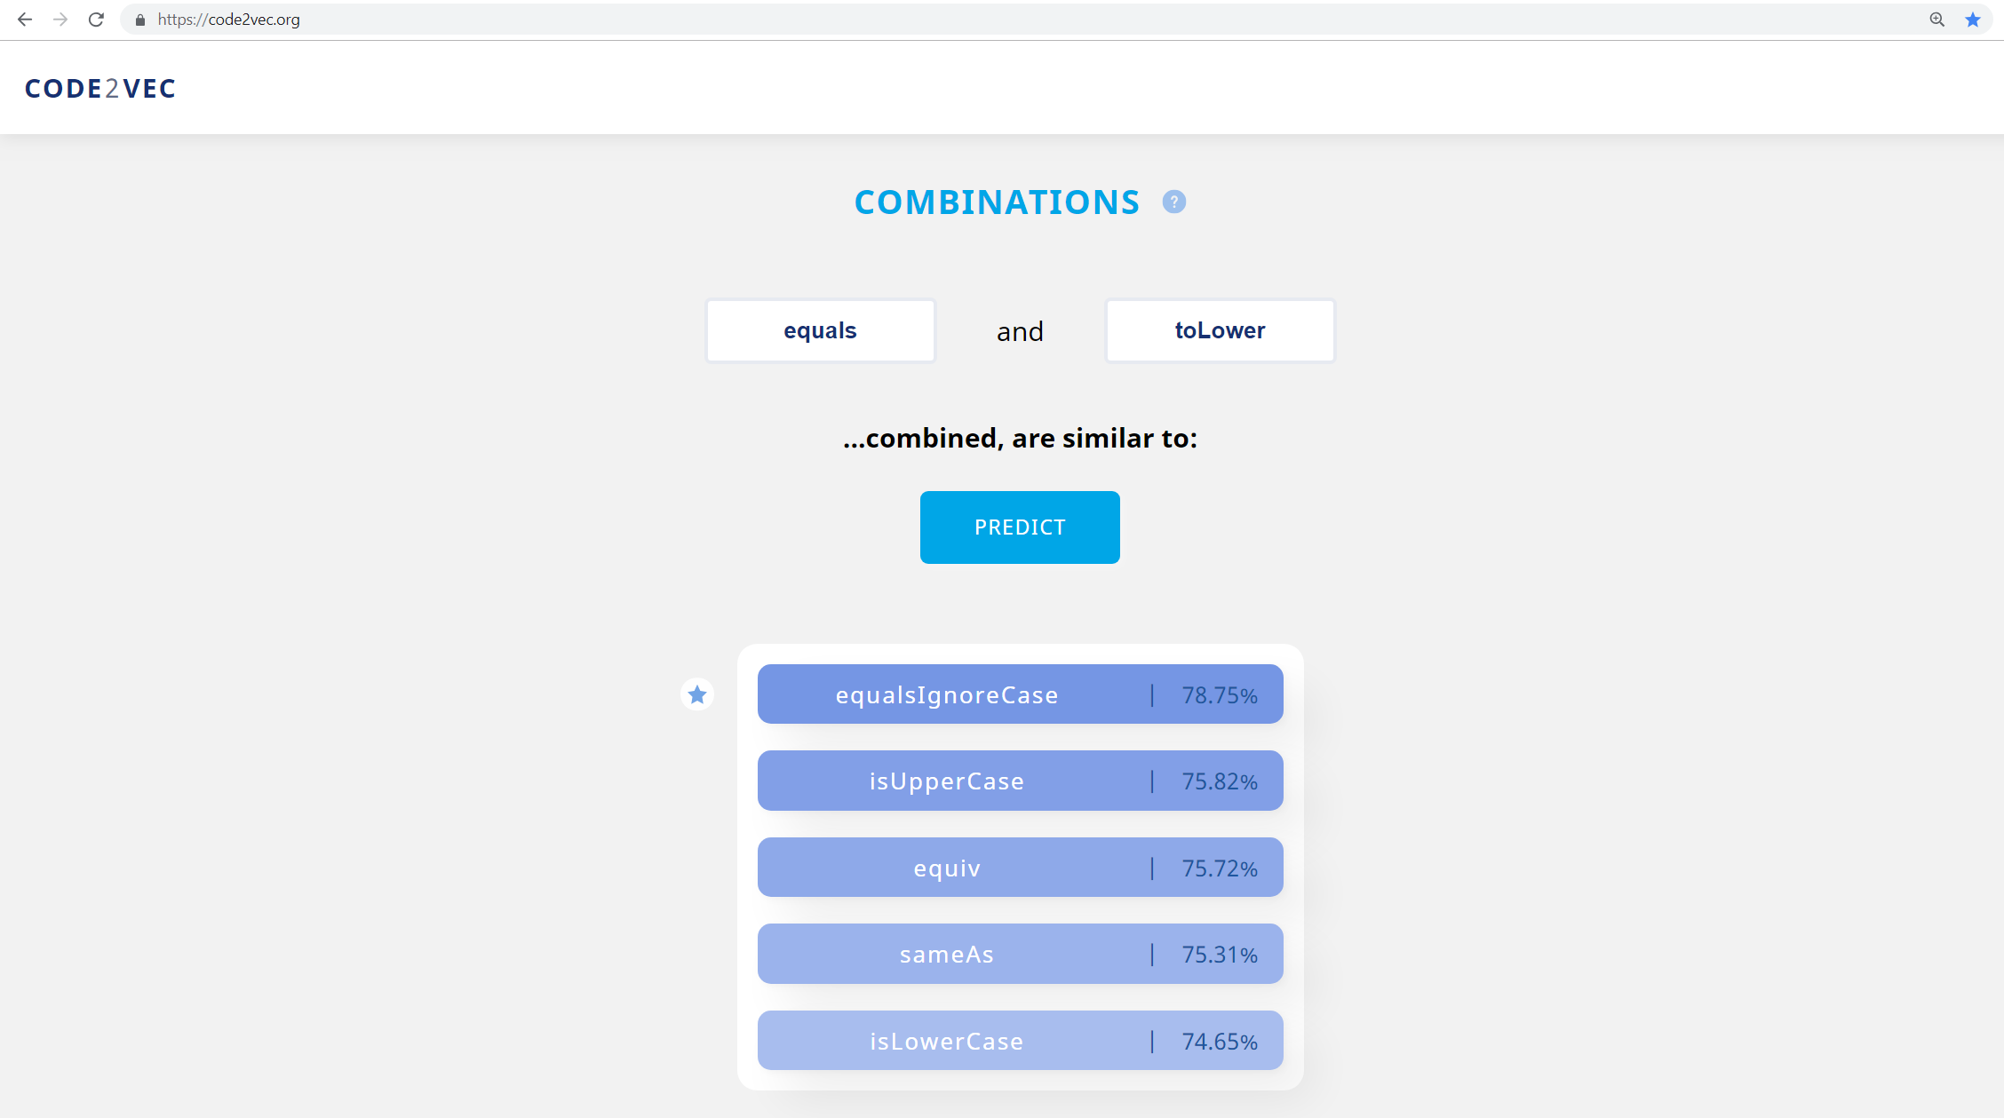

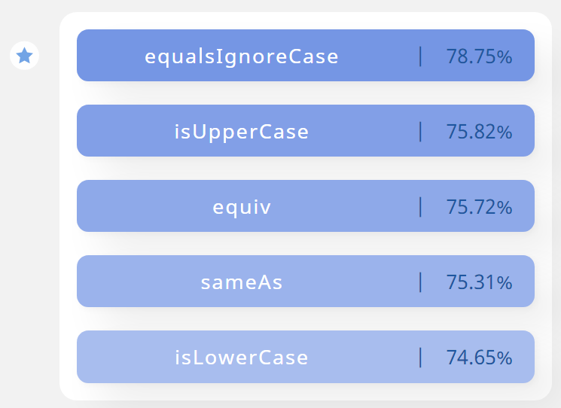
http://code2vec.org

Slide 27
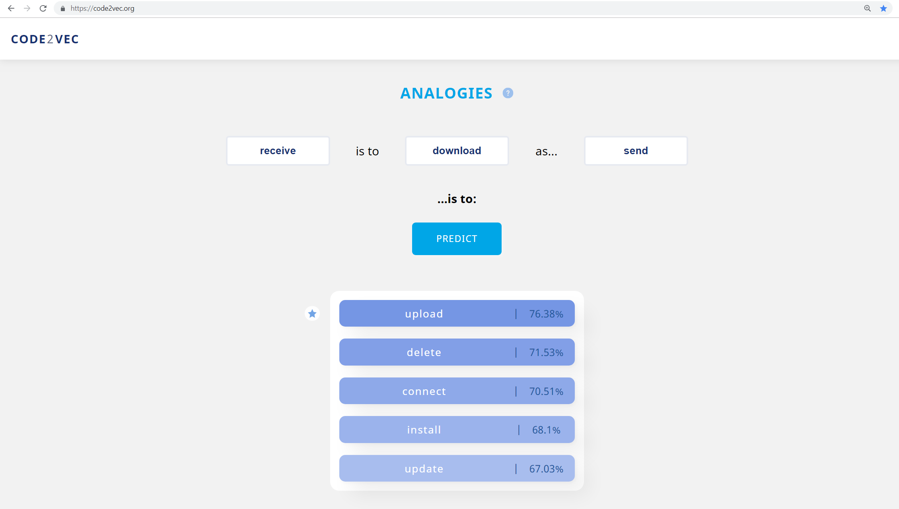
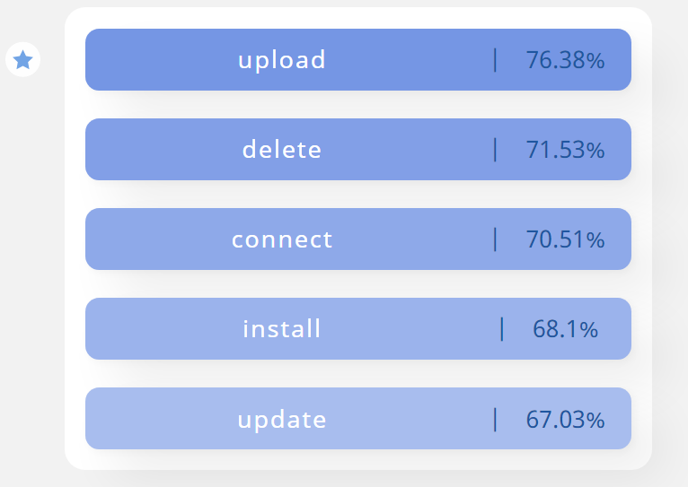
http://code2vec.org

Slide 28
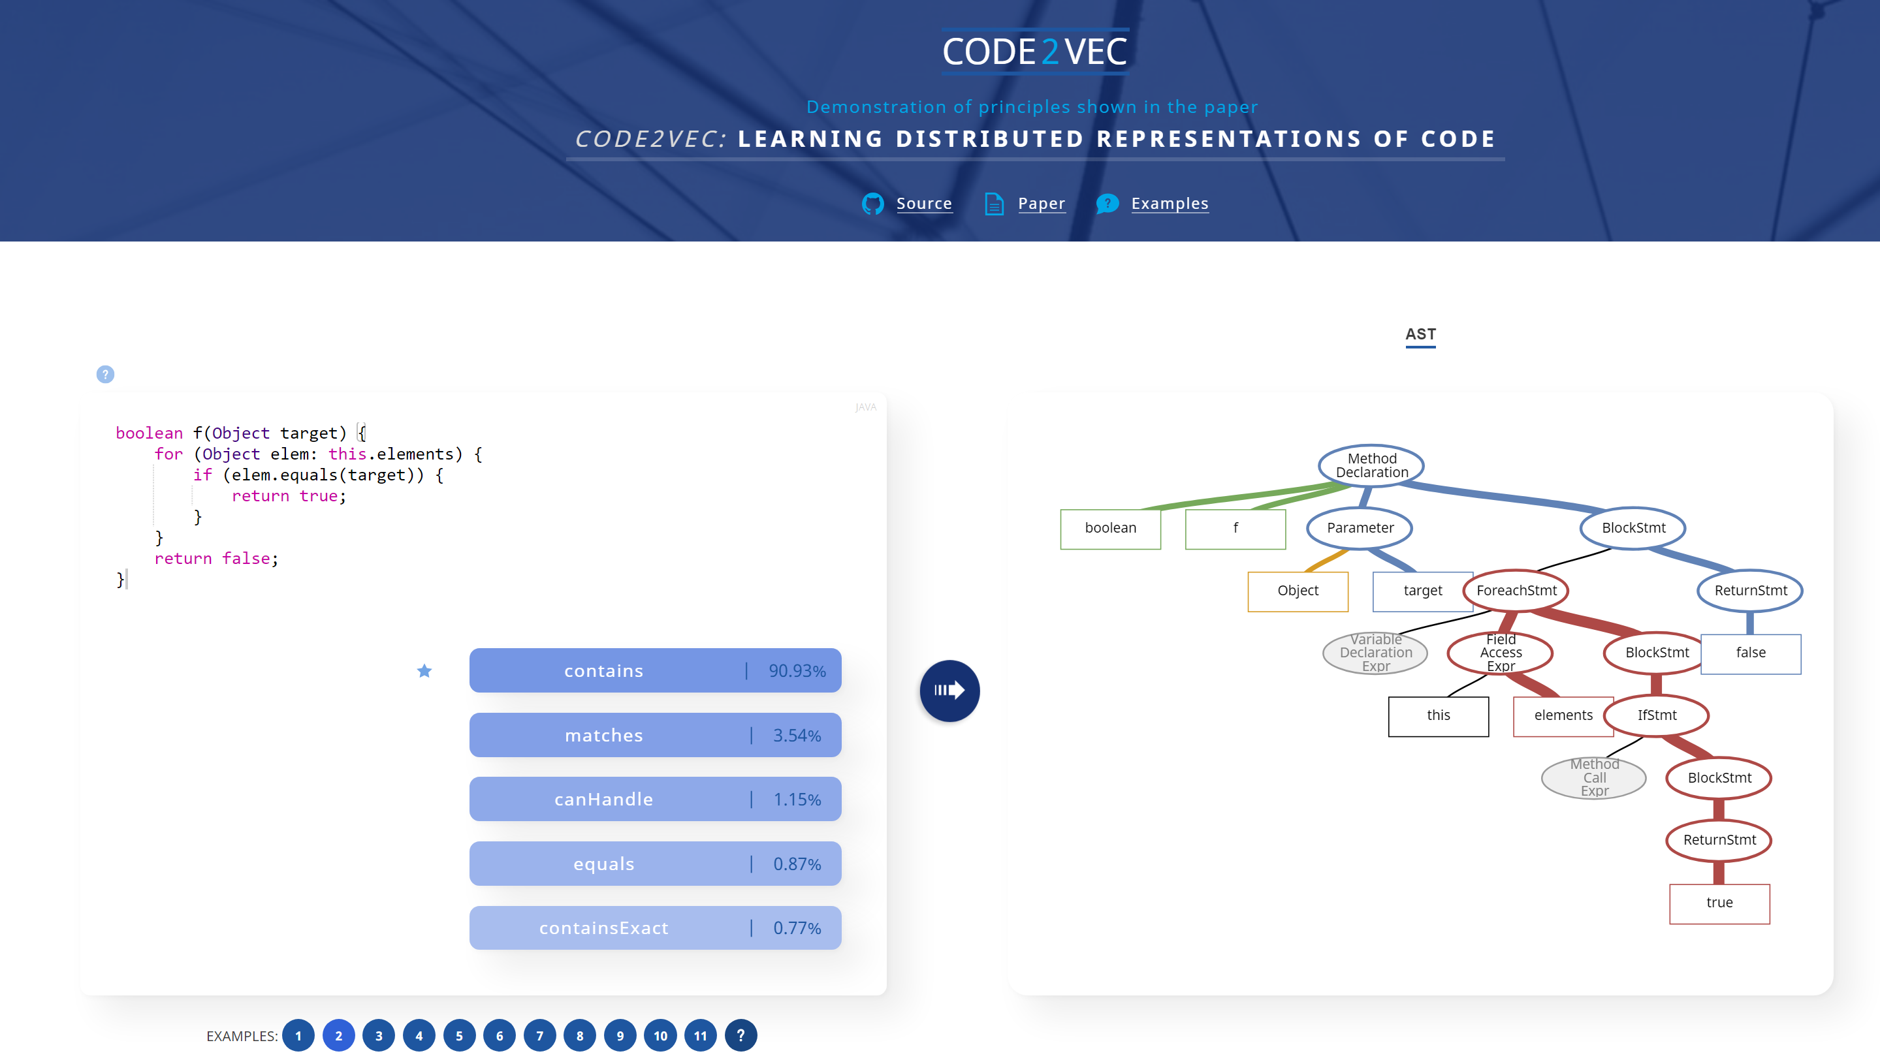
http://code2vec.org

Slide 29
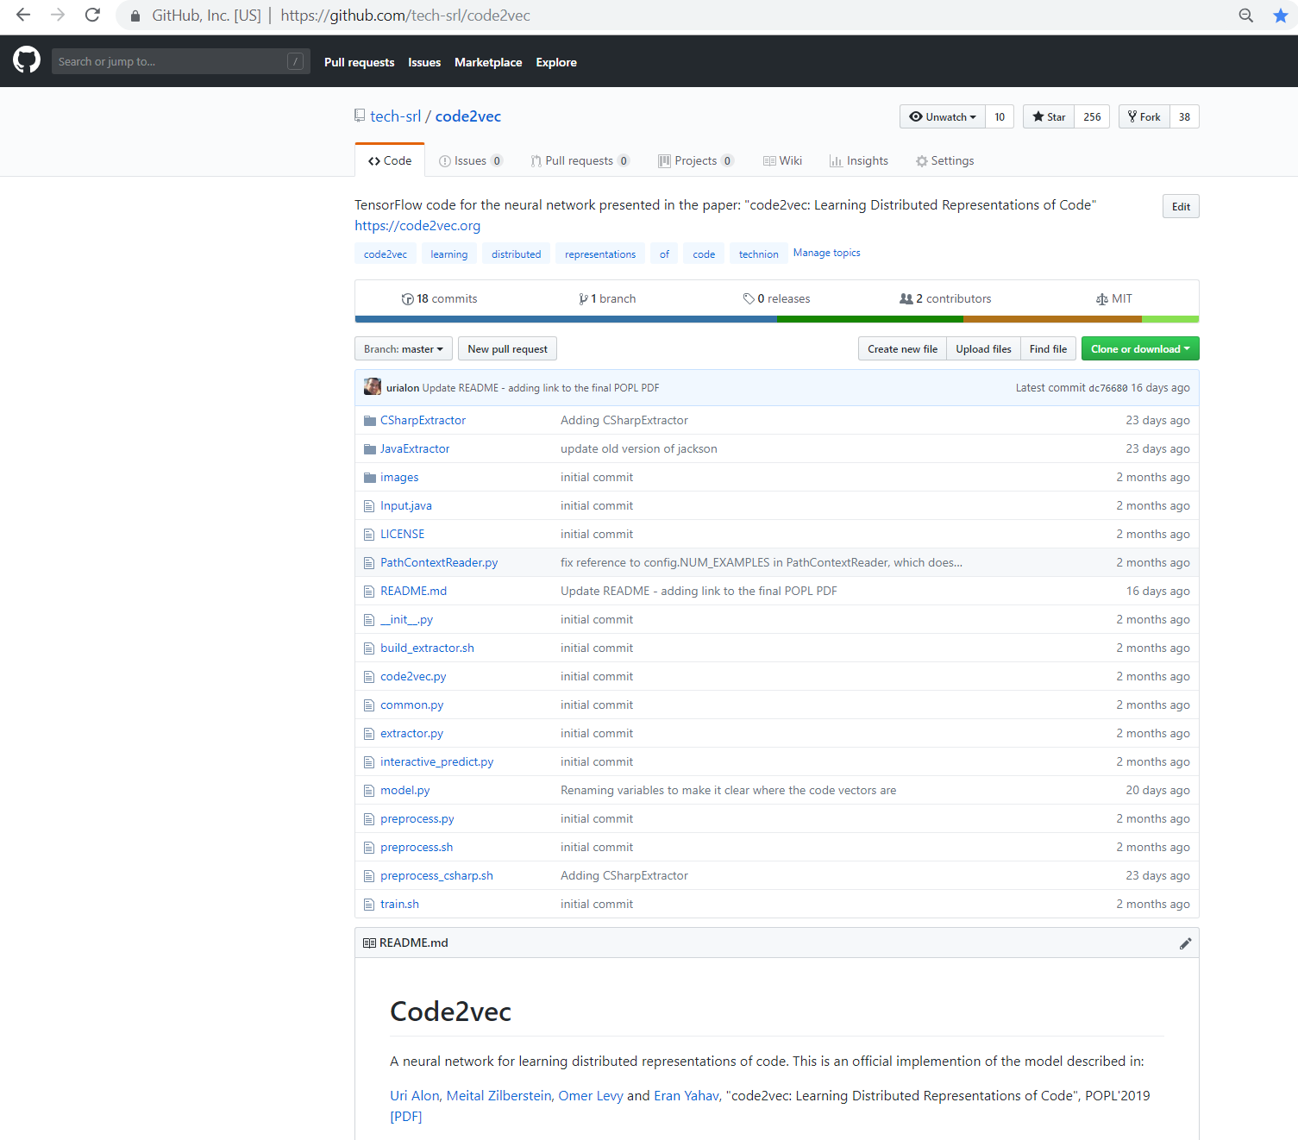
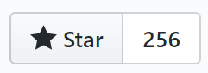

Slide 30
Summary
Core ideas in learning code snippets:
Representing a code snippet as a set of syntactic paths
Aggregate all paths using neural attention
A simple and fast to train architecture
Interpretable thanks to the attention mechanism
The learned vectors capture interesting phenomena
http://code2vec.org

Slide 31
How many paths do you take from each code snippet? Taking all paths is quadratic!
An unlimited number!
Since attention is simply a weighted average, it can handle an arbitrary number of path-contexts.
Empirically, we found that sampling 200 from each code example is sufficient. ~200 is also the average number of paths per example.
This number (200) can be easily increased if the dataset contained especially large pieces of code.
Paths that are missed due to sampling are “covered” by other paths.

Slide 32
Why not performing additional control flow or data flow analyses?
These might help, but we are not sure they are necessary here. Most of the important signals are expressed in the syntax.
Our pure-syntactic approach has the advantage of generality – the same approach can be easily applied to other languages.
Semantic analysis is probably necessary in other tasks (for example, when the programs are binaries).

Slide 33
How robust are the results for variable renaming?
As any machine learning model, confusing or adversarial examples can mislead our model.
Since the network was trained on “well-named” examples from top-starred GitHub projects, it does perform worse without names.
We are exploring similar approaches for obfuscated code as part of ongoing research.

Slide 34
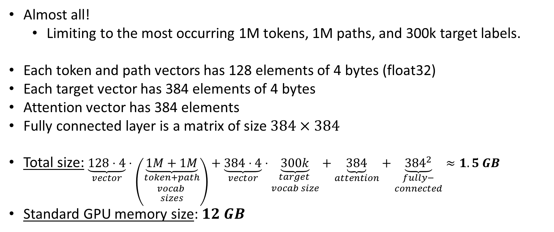
Do you keep vectors for all paths and tokens?
Almost all!
Limiting to the most occurring 1M tokens, 1M paths, and 300k target labels.
Each token and path vectors has 128 elements of 4 bytes (float32)
Each target vector has 384 elements of 4 bytes
Attention vector has 384 elements
Fully connected layer is a matrix of size $384×384$
Total size: $\underset{vector}{\underbrace{128⋅4}}⋅\left(\underset{\begin{aligned}token+path \\ vocab \\ sizes\end{aligned}}{\underbrace{1M+1M}}\right)+\underset{vector}{\underbrace{384⋅4}}⋅\underset{\begin{aligned}target \\ vocab size\end{aligned}}{\underbrace{300k}}+\underset{attention}{\underbrace{384}}+\underset{\begin{aligned}fully− \\ connected\end{aligned}}{\underbrace{{384}^{2}}}≈1.5 GB$
Standard GPU memory size: $12 GB$

Slide 35
Can a non-neural model solve the same task?
Yes, and pretty well (PLDI’2018).
But not as good as a neural model.
Main advantages of using a neural network:
Much better generalization (Section 5 in the paper)
Our neural network can produce a vector, which can be fed to a variety of other (neural and non-neural) ML models and tasks.

